Slide 1
Help Me

Slide 2
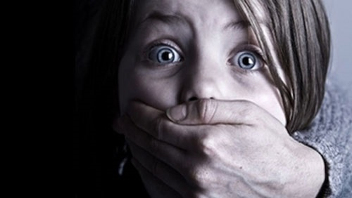

Slide 3
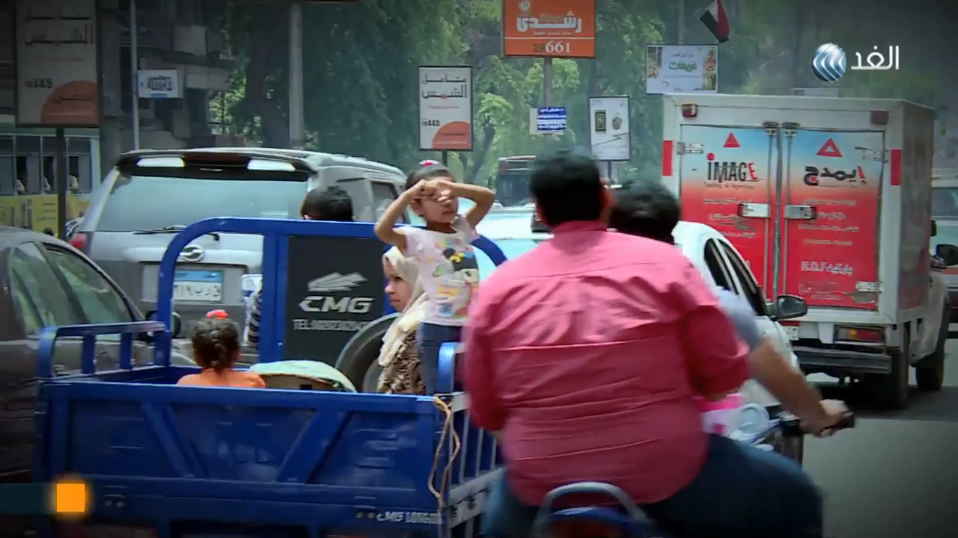

Slide 4
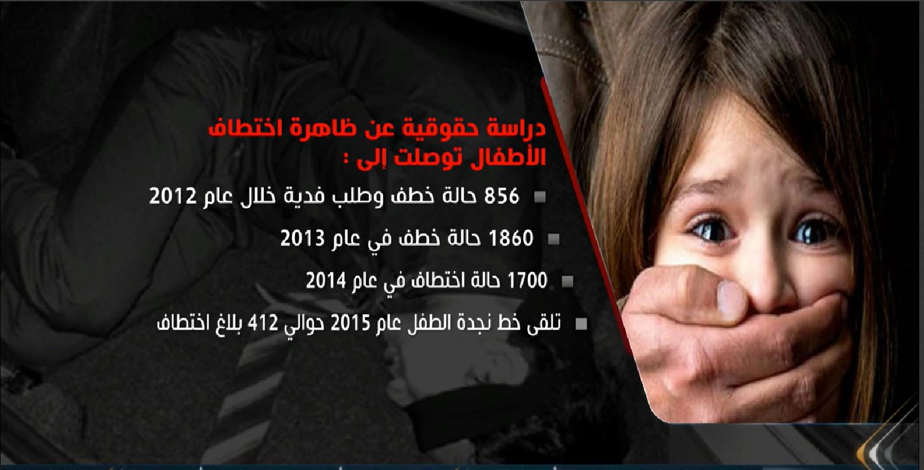

Slide 5
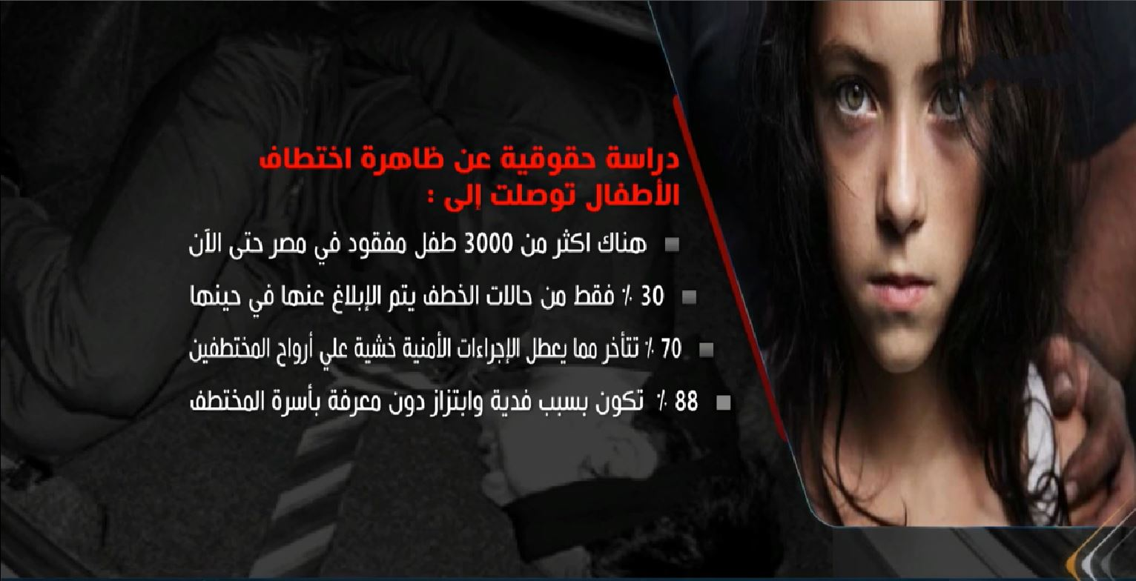

Slide 6
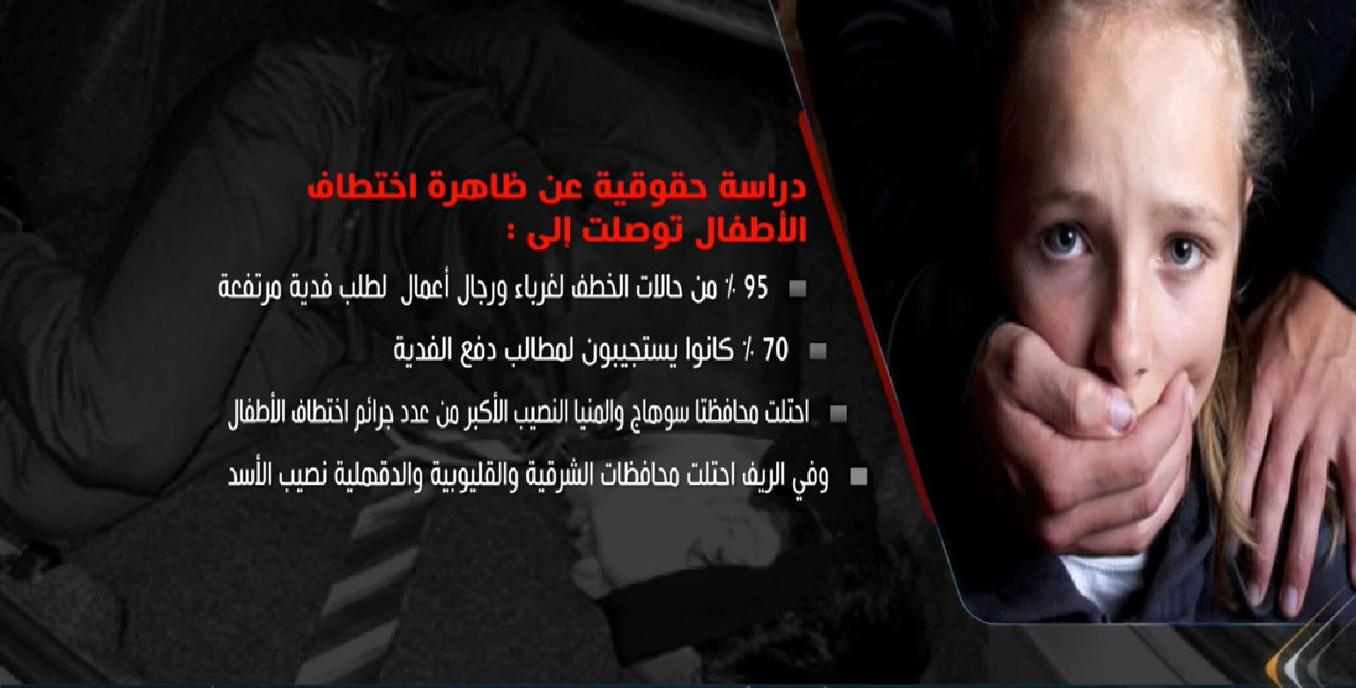

Slide 7
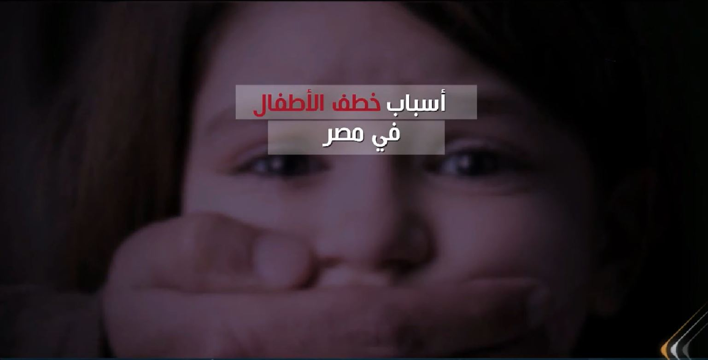

Slide 8
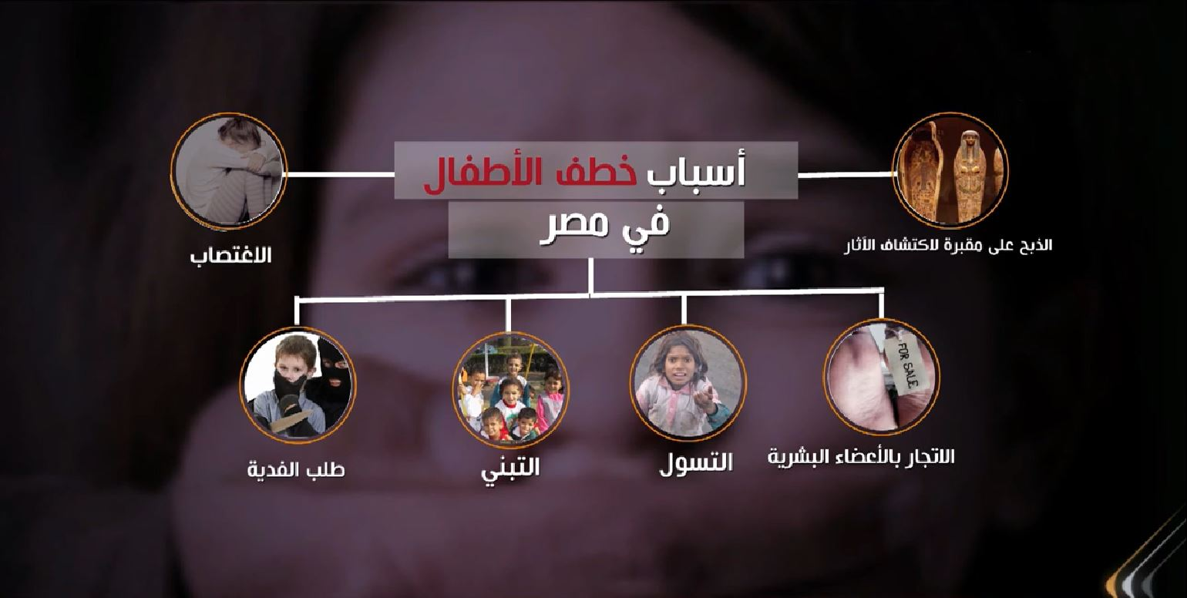

Slide 9
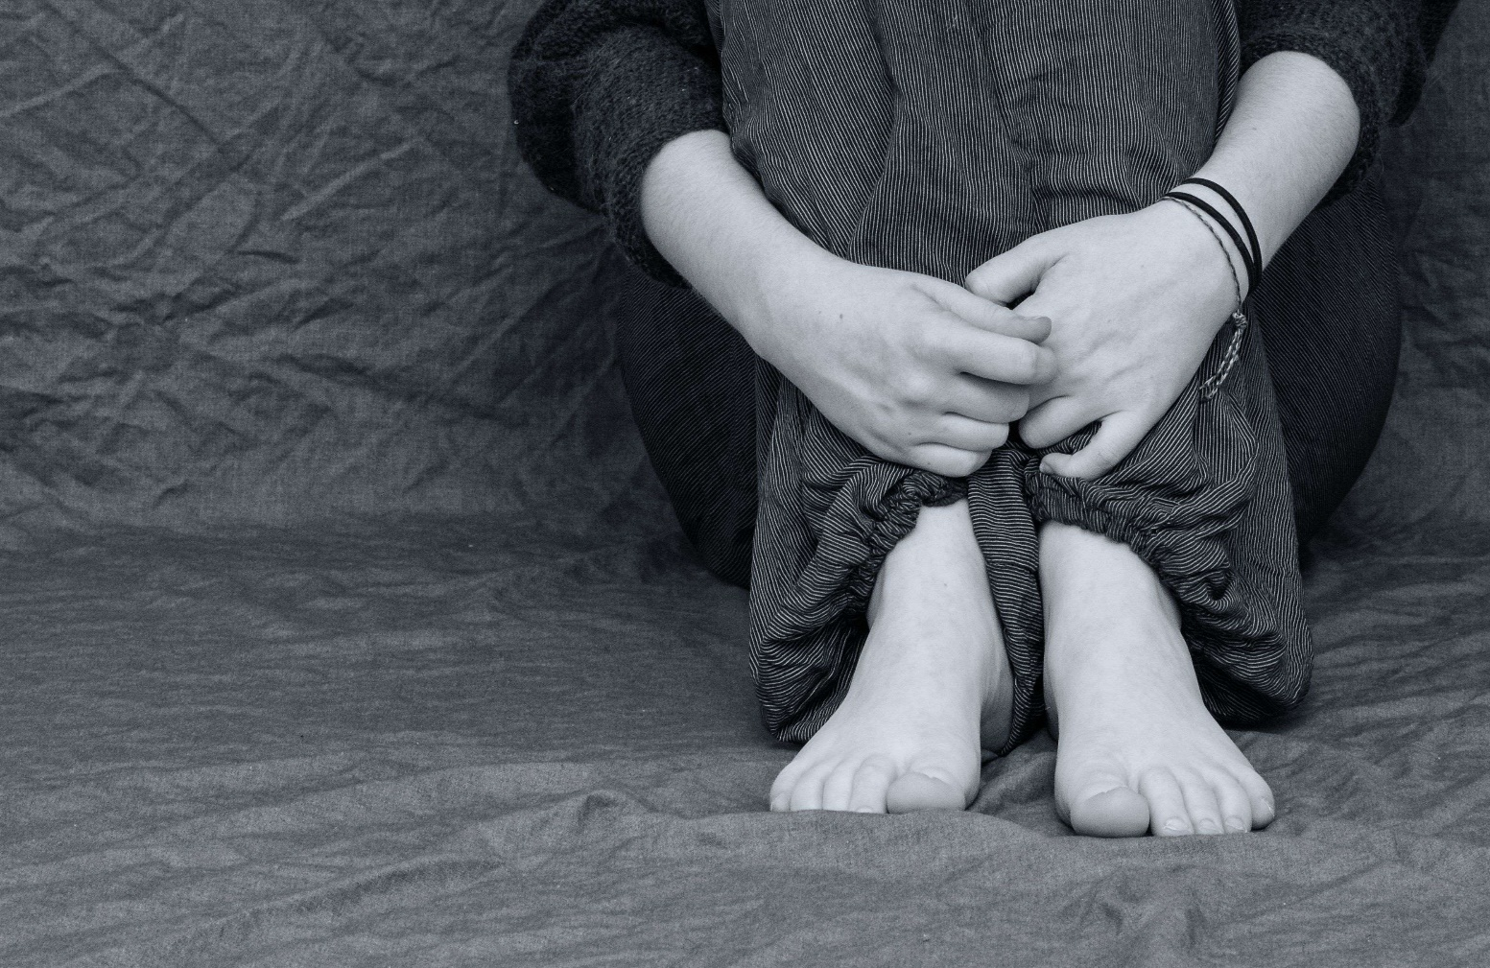

Slide 10


Slide 11
Existing Solutions

Slide 12
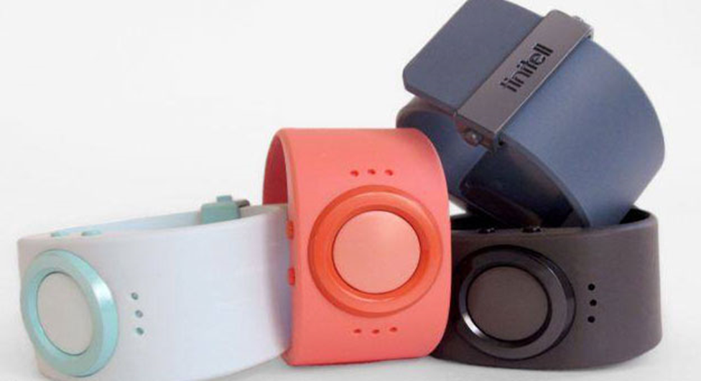
1-Smart Watch

Slide 13
Description
Tinetell has launched a smart children's watch to protect against hijacking,
allowing parents to track their children through GPS.
Which is provided by the clock.
With Smart Clock, you can watch your child and talk to him face-to-face as
the clock is connected to an application on the phone.
It also allows you to talk with your child, and also to program them to call
the numbers on them when the child says certain words.

Slide 14
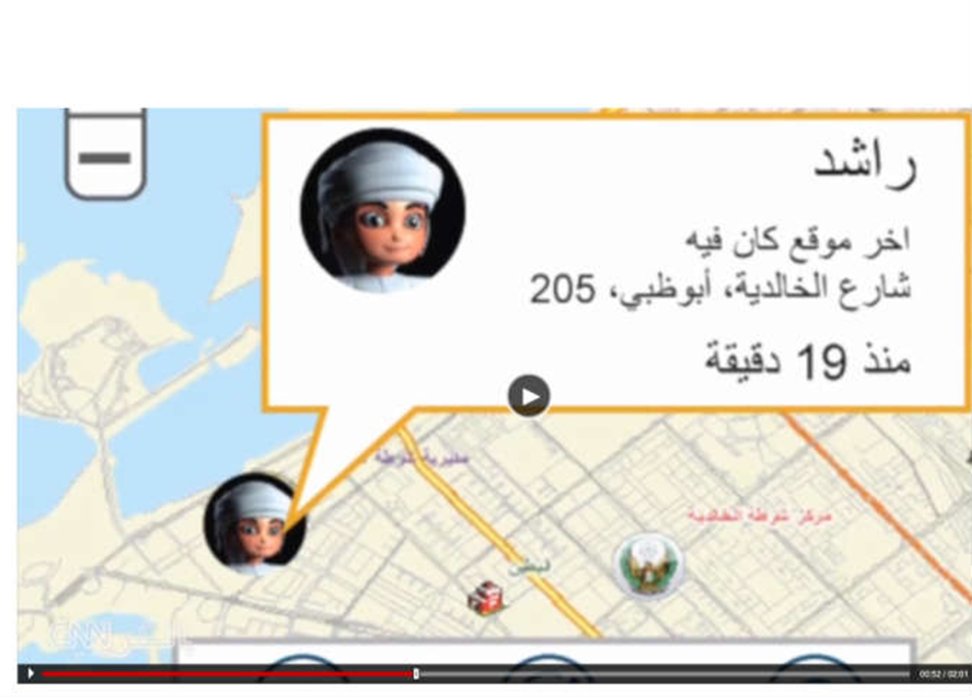
2-Myprotection app

Slide 15
Description
the application of protection
An application by Dubai Police for the safety and protection of children from
abduction, the idea of application on a bracelet placed by the child can parents
to track their children and know their location, as well as to determine the
geographical location.
It also includes a call-to-distress feature, a close-up feature that allows
parents to know when the child is boarding the school bus and when it is
coming off, and gives an alarm if a bus is traveling wrongly, changing the
area to travel, Selected for the road.

Slide 16
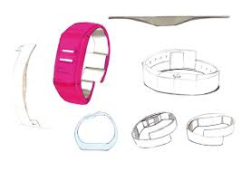
3-Electroinc bracelets

Slide 17
Description
Electronic bracelets
A new method to protect children from kidnapping, especially in hospitals and
nurseries, is placed around the wrist to protect the child from abduction and
exit from the hospital, when any manipulation of the movement of the child and
change in his direction from the direction of the room where his mother is
the device is transmitting the waves connected to the tracking device And is
connected to alarms after the launch of the siren completely close all the
entrances and exits of the hospital in full, these bracelets are known
as hug and kisses.

Slide 18

4-Guardian device

Slide 19
Description
Guardian is a small device equipped with a Bluetooth "Bluetooth" and can be
worn as a wrist in the neck or necklace in the neck or hang on children's
clothes, and continues this device with the application installed on the
smartphone, making the son under the eyes of parents can be located in the
case of loss.
The application will tell you where your child is when he approaches the
Bluetooth domain limits. If your son is outside the Bluetooth range,
a network is established that connects the parents to each other, helping to
locate the lost son through the Bluetooth range closest to him and thus
communicating with the lost son.

Slide 20
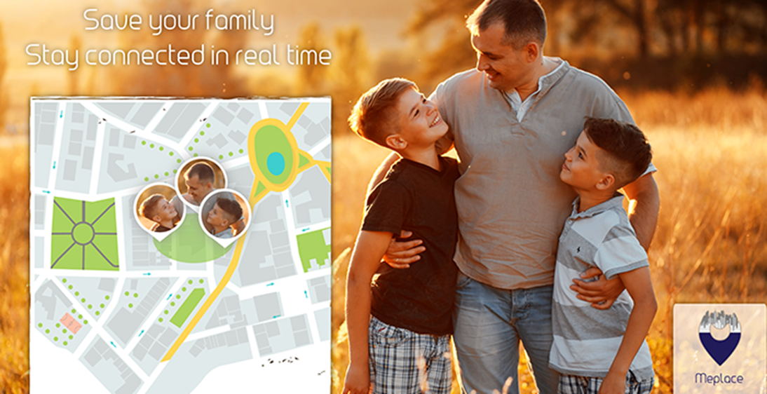
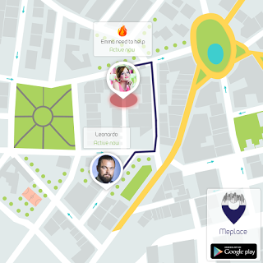
5-MePlace app

Slide 21
Description
This application is known to know where your family or friends are located in
real time. You can also send a message to your friends about the application,
your location, your correct details and also the details of the way to get to
you as soon as possible.
First you have to download the application and the person you want to know the
place to rest on it and then you have to add it in the application on your
application, then it will show you the person on the application and you can
locate it in the current time in the second and one minute and the
application will show you the nearest way You can reach him for the person
you are adding to the map.

Slide 22


Slide 23


Slide 24
Disadvantages
1-boor availability of the devices at most places
2-implement just one module
3-high prices

Slide 25
Advantages
1-Get location offline
2-check the status of followers connected or not
3-posting
4-dangerous area warning

Slide 26
Our Application

Slide 27

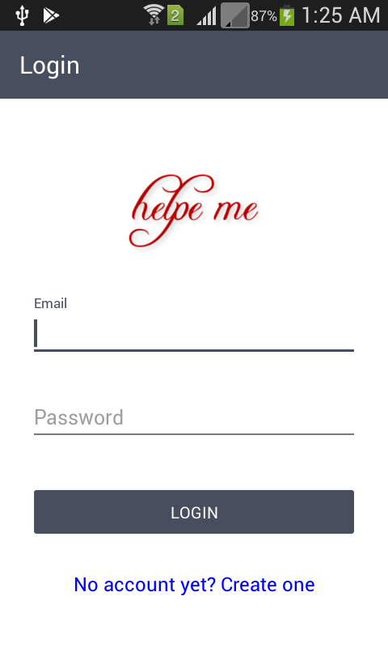
Welcome Screen then Login Screen

Slide 28
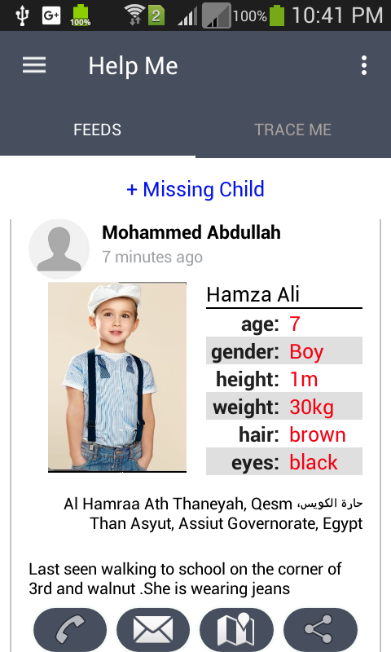
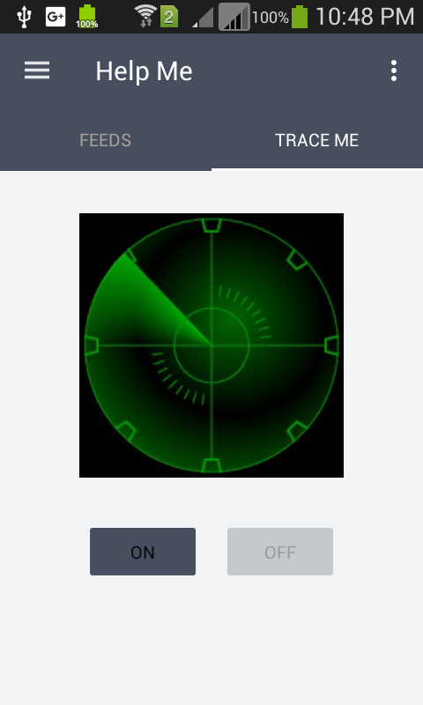
Home Activity

Slide 29
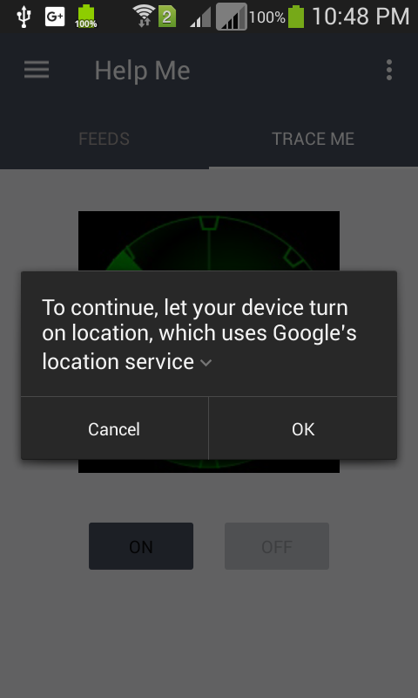
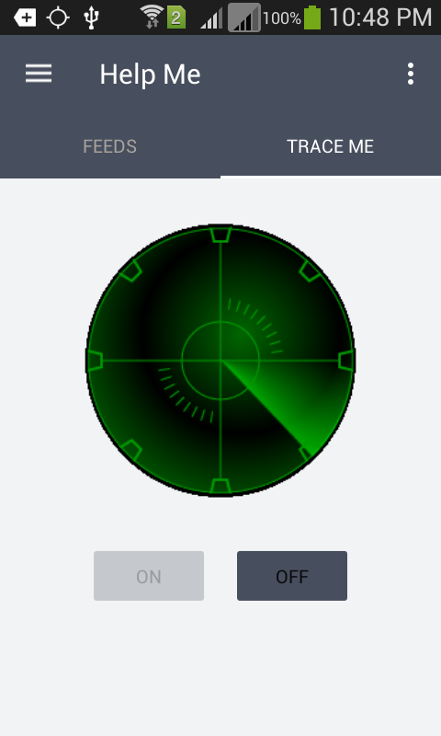
Turn Tracking of

Slide 30
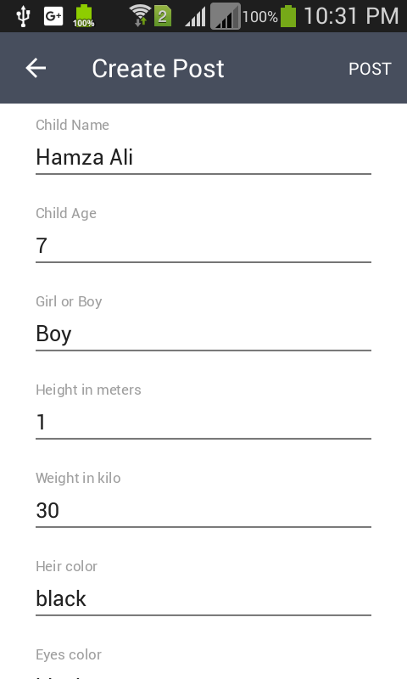
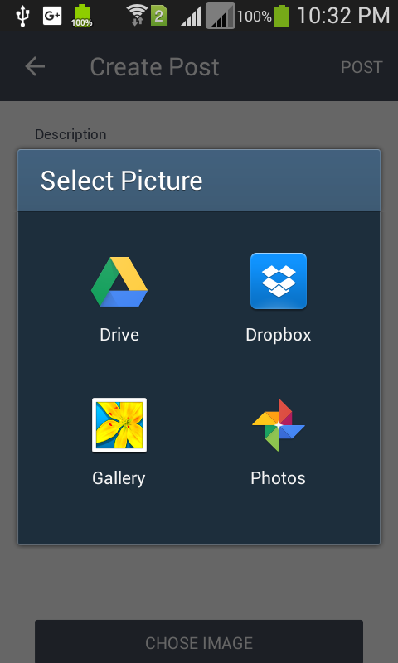
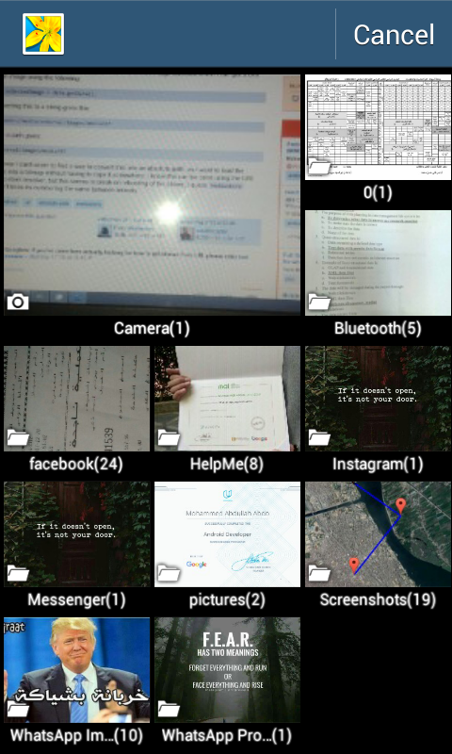
Share Missing Child

Slide 31
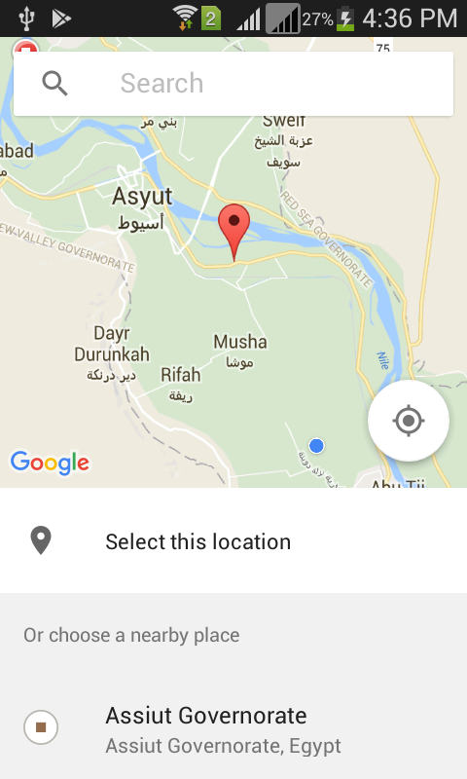
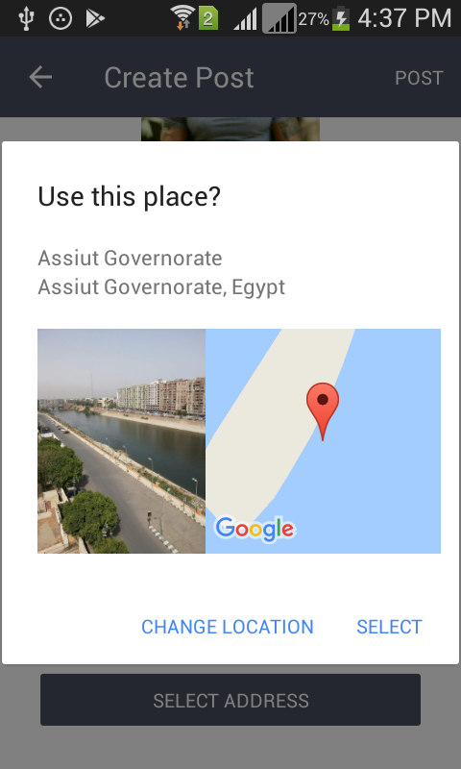
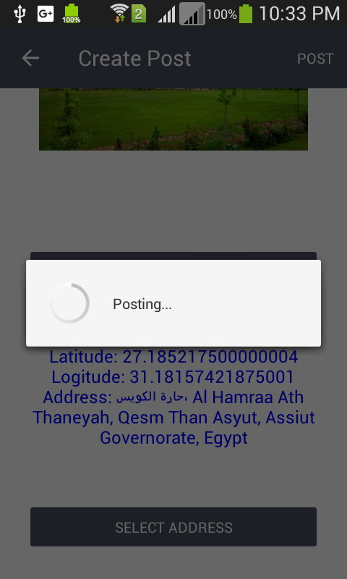
Share Missing Child (.con)

Slide 32
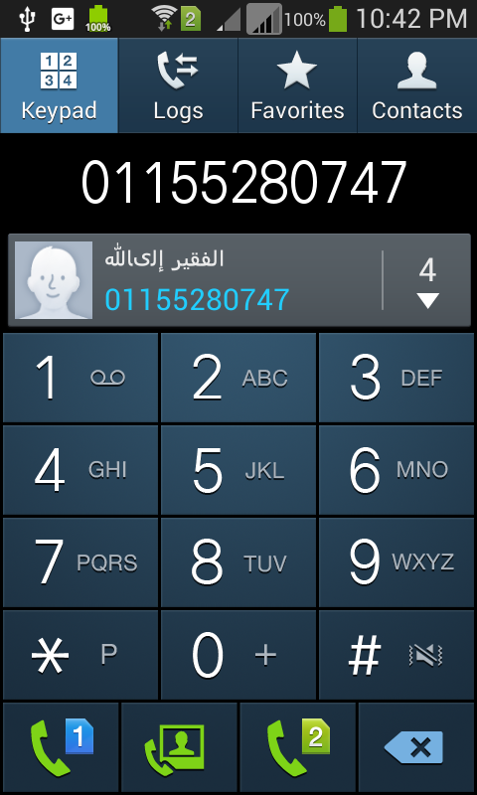
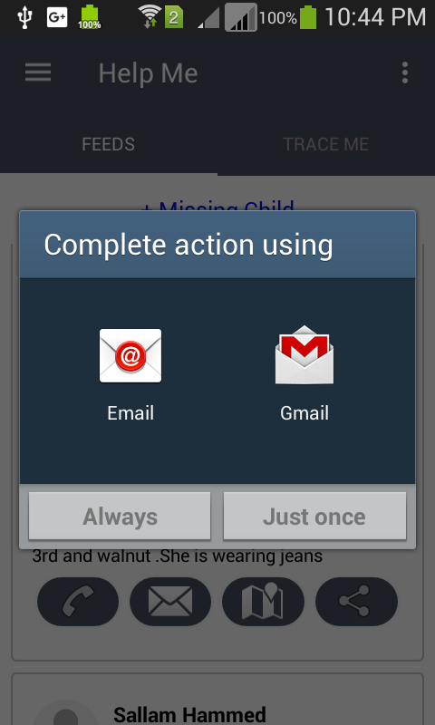
Interact with the post .

Slide 33
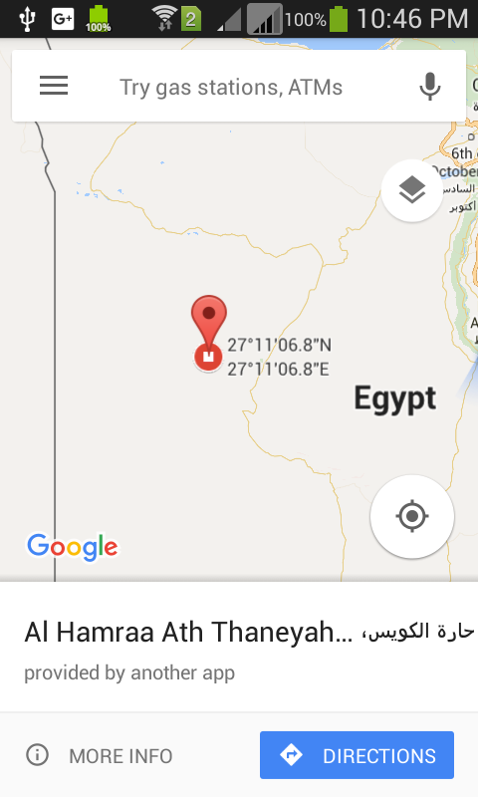
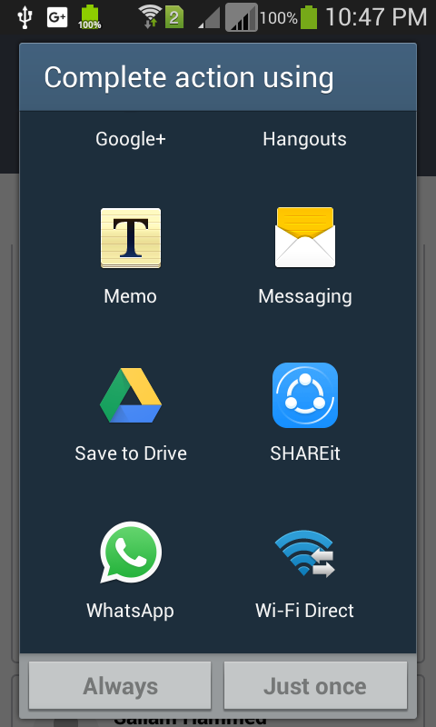
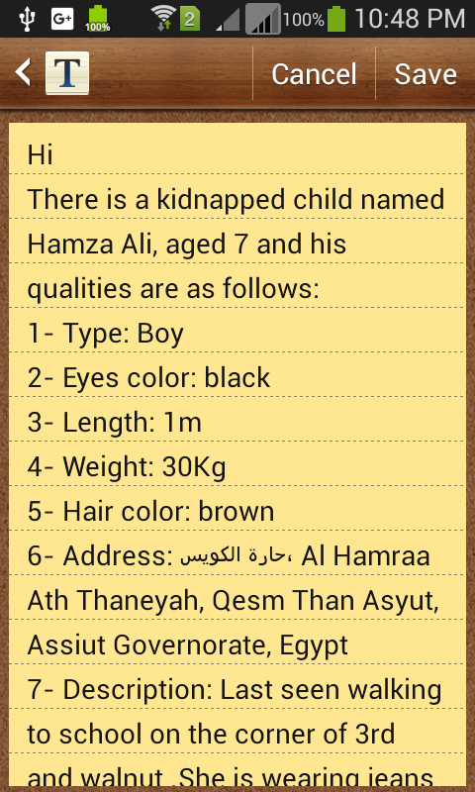
Interact with the post .con

Slide 34
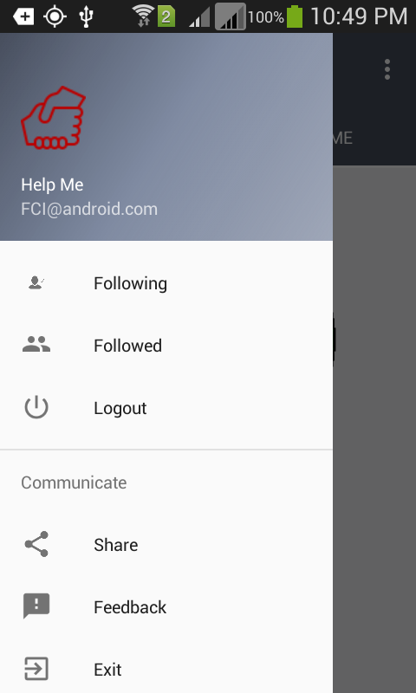
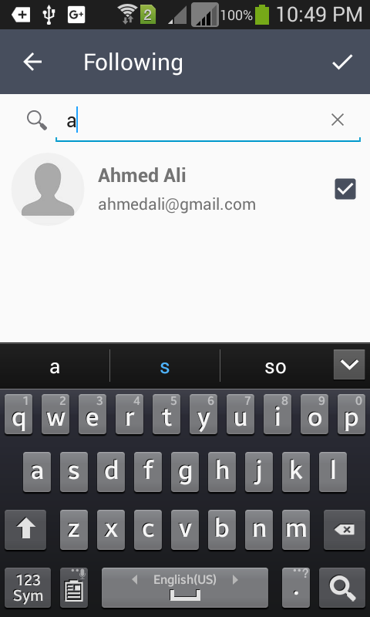
Following People

Slide 35

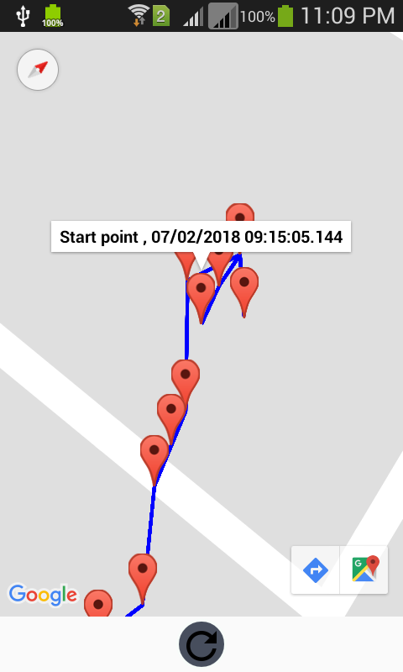
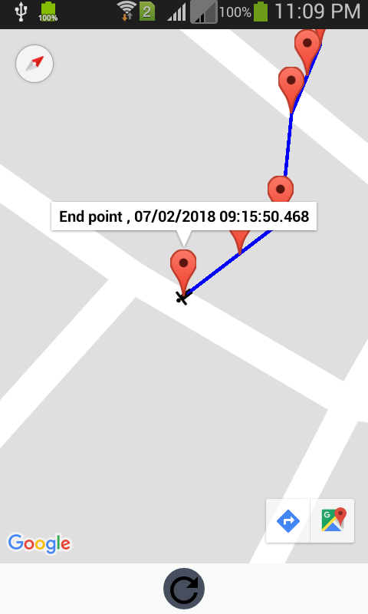
Followed

Slide 36
Help Me App modules
Module 1: inform about abduction or missing person
Module 2: protection against abduction
Module 3:Dangerous Places Warning
Module 4: Photographing and uploading image for the people that looked like kidnapped or lost

Slide 37
Inform about abduction or missing person

Slide 38
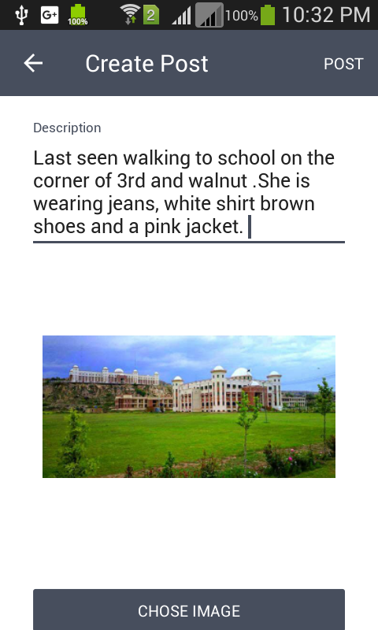
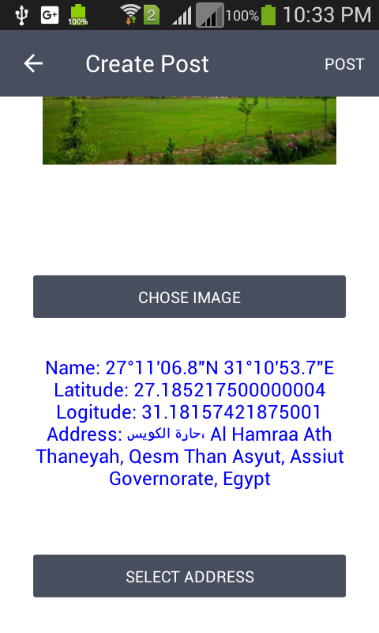

Slide 40
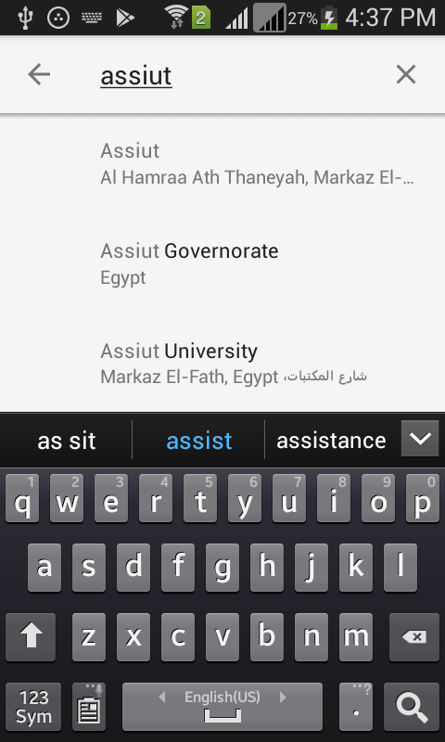

Slide 41
Tracking

Slide 42
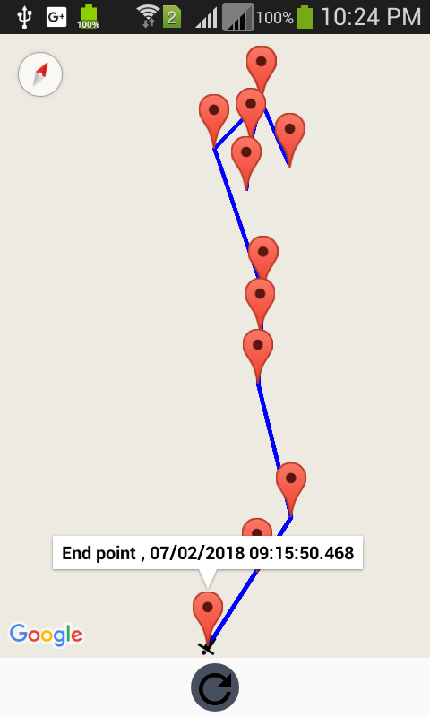

Slide 44



Dangerous Places Warning

Slide 45
Photographing and uploading image for the people that looked like kidnapped or lost

Slide 46


